Slide 1
Basics of Port Addressing
CSE320 – Data Communications
Department of Computer Science and Engineering School of Data & Science

Slide 2
Port Addressing
What does port number mean?
How this port number is assigned?
Port number ranges
Port number in real devices

Slide 3
Port Addressing
A port address identifies a specific application or process running on a host(computer/server).
At the software level, within an operating system, a port is a logical construct that identifies a specific process or a type of network service.
Destination Port address (16 bits) | Source Port address (16 bits) | Data

Slide 4
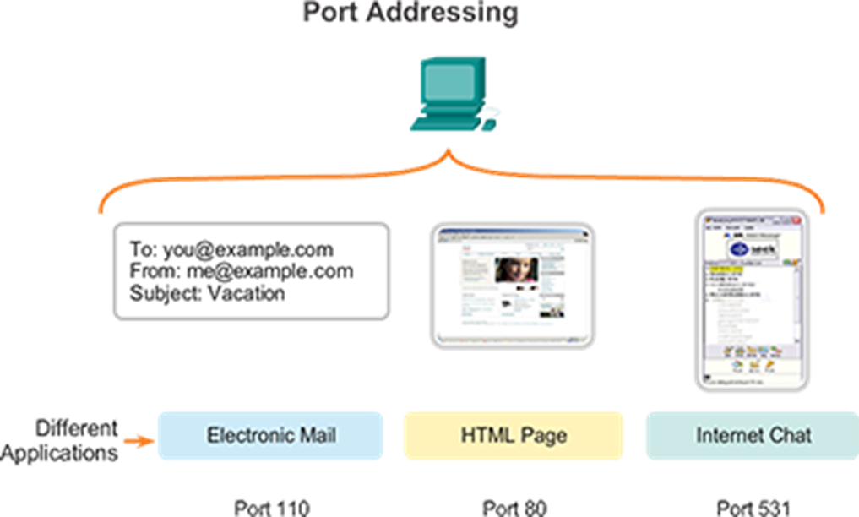
How to assign port number?
To differentiate the data for each application, Transport layer uses port numbers.
From Computer to Server
Dest. Port: 110 | Source port:49155 | Email Data
Source Port number: assigned by OS
Dest. Port: 80 | Source port: 49156 | HTML Page
Dest. Port: 531 | Source port: 49157 | Chat Data
From Server to Computer
Dest. Port: 49155 | Source port:110 | Email Data
Dest. Port: 49156 | Source port: 80 | HTML Page
Dest. Port: 49157 | Source port: 531 | Chat Data
Destination Port number

Slide 5
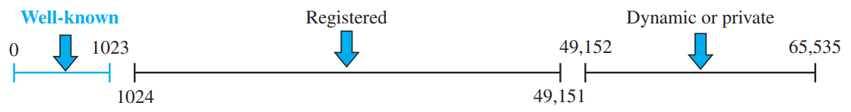
Port Number Ranges
Well-known ports: The ports ranging from 0 to 1023 are assigned and controlled by ICANN. These are the well-known ports used by the servers.
Registered ports: The ports ranging from 1024 to 49,151 are not assigned or controlled by ICANN. They can only be registered with ICANN to prevent duplication.
Dynamic or private ports: The ports ranging from 49,152 to 65,535 are neither controlled nor registered. They can be used as temporary or private port numbers.
Clients can use any private port number, servers can’t. Because clients won’t be able to identify server process otherwise.

Slide 6
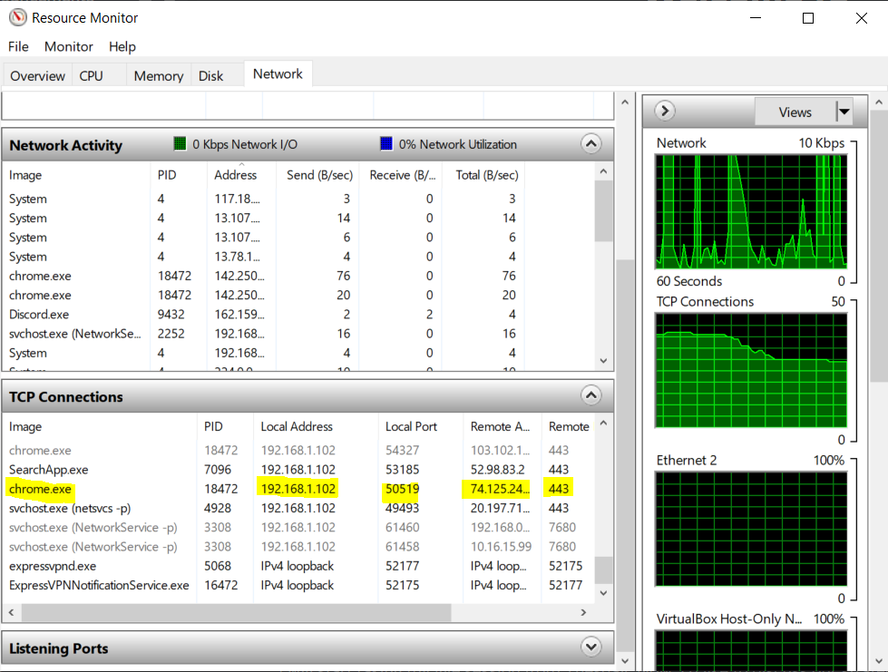
Port number in real devices
Type resmon in cmd
Some Notable well-known port numbers
Number | Assignment
20 | File Transfer Protocol (FTP) Data Transfer
23 | Telnet remote login service
25 | Simple Mail Transfer Protocol (SMTP) email delivery
80 | Hypertext Transfer Protocol (HTTP) used in the World Wide Web
443 | HTTP Secure (HTTPS) HTTP over TLS/SSL

